Slide 1

Strategies for Success on the
Academic Clinician Track:
Building Your Area of Concentration
QUESTIONS DURING SESSION? staitano@upenn.edu
James M. Callahan, MD
Chair, Academic Clinician Advisory Committee
to the
Committee on Appointments and Promotion
9 January 2020

Slide 2
The Academic Clinician Track
The major emphases of the Academic Clinician (AC) track are clinical care, quality and safety, and education, including leadership roles in these domains. Although research is not a required focus for this track, ACs may participate in, and in some circumstances lead, clinical trials.
http://www.med.upenn.edu/flpd/academic-clinician.html
QUESTIONS DURING SESSION? staitano@upenn.edu

Slide 3
The Academic Clinician Track:
General Principles
The allocation of an Academic Clinician’s time is determined by the department chair (or designee) in light of the strategic and programmatic needs of the department and school.
Typically, Academic Clinicians will spend about 90% of their time engaged in clinical work with the balance of their time engaged in teaching and other local activities.
  These percentages may be adjusted to accommodate the performance of administrative or educational duties as well as engagement in clinical research including trials activities.
QUESTIONS DURING SESSION? staitano@upenn.edu

Slide 4
AC Track: Appointment and Promotion Criteria
The major criteria for appointment, reappointment and promotion for Academic Clinicians are:
  Excellence in clinical care
  Excellence in teaching
  Excellence in the candidate’s selected area of concentration (AOC)
  Sustained professionalism
The AC Advisory Committee to CoAP weighs the evidence
http://www.med.upenn.edu/flpd/metrics-for-promotion-(academic-clinician).html
QUESTIONS DURING SESSION? staitano@upenn.edu

Slide 5
Criteria for Reappointment and Promotion for AC Reviews
Promotion to Associate Professor
  Have completed 6 academic years in track (after 2nd reappointment)
  Sustained evidence of professionalism
  Teaching Excellence
  Clinical Excellence
  Have developed area of concentration (broadly defined)
Promotion to Professor
  At least 5 years at the Associate level (after reappointment)
  Sustained evidence of professionalism
  Teaching Excellence
  Clinical Excellence
  Accomplishment in area of concentration (broadly defined)
  Reputation (clinical/AOC) beyond primary practice site
http://www.med.upenn.edu/flpd/metrics-for-promotion-(academic-clinician).html

Slide 6
Area of Concentration (AOC)
Candidates will identify an area of concentration; AOC represents a depth and focus chosen by the individual
May be clinical or nonclinical:
  Clinical expertise or specialization and leadership, or
  Education, community service, advocacy, quality and safety, health policy, global health, diversity and inclusion
Required for all actions at Associate and Full Professor Ranks and reappointments from the 2nd reappointment on at the rank of Assistant Professor (should be noted on reappointment and promotion materials)
Contributions and excellence at the local level (Associate Professor) or beyond local practice site (Professor)
QUESTIONS DURING SESSION? staitano@upenn.edu

Slide 7
General Strategy for Success in Academic Medicine
Know your role – what is expected of you (Academic Plan)
Identify mentors who understand your personal career goals, what you are passionate about and Penn’s expectations; then be an engaged mentee!
Be organized
Find your passion – clinically
Find you passion – teaching (develop your niche); teach content you know in domains you enjoy
Be a good citizen; follow through and do a good job
QUESTIONS DURING SESSION? staitano@upenn.edu

Slide 8
Clinical Success
Take care of patients you like to care for; develop your niche
Stay current clinically
Get to know your patients and families
If there is a need in your department or division consider how you can help address it
Be responsive: patients, families, colleagues, staff
Find joy in your work and embrace the privilege of caring for patients
QUESTIONS DURING SESSION? staitano@upenn.edu

Slide 9
Teaching Success
Embrace teaching; be an enthusiastic teacher
Find your niche – what do you have to contribute
Don’t be afraid of TED – look at your data and learn from it
Accept opportunities, follow through, do a good job
Teach trainees you respect and in whom you see potential
Share the privilege and love you have for providing outstanding care with the next generation of our colleagues
Foster the careers of others (be an engaged mentor)
QUESTIONS DURING SESSION? staitano@upenn.edu

Slide 10
Area of Concentration
What do you that really gets you excited
Compliments your clinical and teaching efforts
May be clinical or non – clinical
Discuss what you are interested in with your mentors and departmental/divisional leadership
Get involved, volunteer, do a good job
Look for and accept leadership roles
Enjoy it!
QUESTIONS DURING SESSION? staitano@upenn.edu

Slide 11
Area of Concentration
Share your work and your knowledge
Develop guidelines, curriculum, new models of care
Innovate
Speak and/or write
Contribute to research
Develop others’ skills
Leadership roles
Awards
QUESTIONS DURING SESSION? staitano@upenn.edu

Slide 12
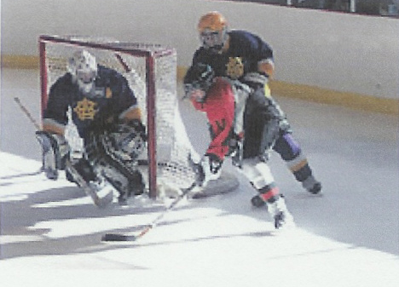
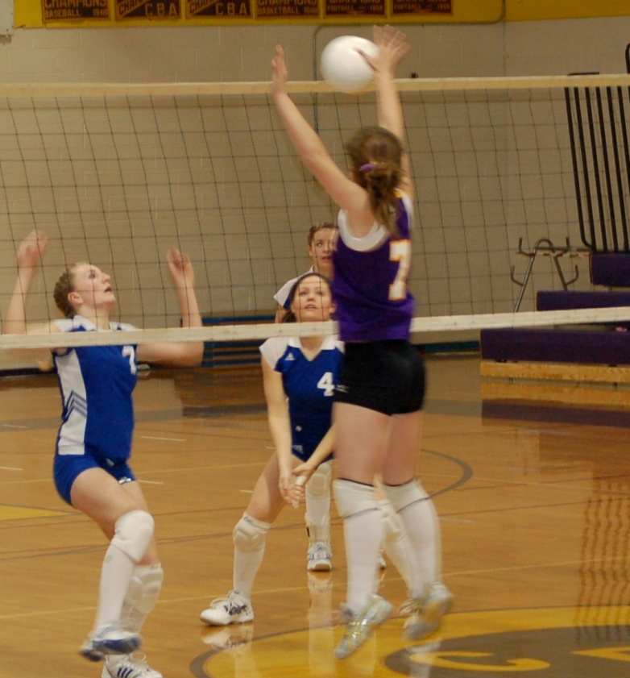

Developing an AOC (AOCs?)
Uniting passion and expertise
Looking for collaborators
Making a difference – locally
Saying yes to opportunities
Having fun
Broader contributions
QUESTIONS DURING SESSION? staitano@upenn.edu

Slide 13
Developing an AOC (AOCs?)
Interest in education
Looking for opportunities to teach
Helping develop curriculum for a set of learners
Being asked to take on a role within your division, department of PSOM
Overtime, leadership role in education
QUESTIONS DURING SESSION? staitano@upenn.edu

Slide 14
AOCs for Recently Promoted Faculty
Out-of-OR Anesthesia
Clinical care and developing interdisciplinary standards of care for pediatric vascular malformations
Adolescent substance use evaluation and treatment
Specialized care for pediatric craniofacial abnormalities
Clinical care and program direction – lobular breast cancer and care of patients at high risk for breast cancer
Clinical care and program leadership – interstitial lung disease
Information technology for diagnosis and early warning in cardiology
QUESTIONS DURING SESSION? staitano@upenn.edu

Slide 15
AOCs for Recently Promoted Faculty
Residency Program Director – emphasis on increasing diversity and inclusion
Development of multidisciplinary airway management curriculum for trainees
Medical Informatics leadership
Critical Care Quality Improvement
Development of peer mentorship program
Enhancing physician communication skills
Medical Administration – CMO
Development of genomic diagnostics

Slide 16
Demonstrating Excellence in AOC
All ranks:
  Invitations to share expertise through invited talks, book chapters, clinical reviews.
  Leadership roles
  Service on committees (local, Health System, regional and national)
  Awards for teaching, mentoring or innovation
  Engagement in clinical trials
QUESTIONS DURING SESSION? staitano@upenn.edu

Slide 17
Excellence in Area of Concentration
Professor:
  Development of innovative approaches to AOC including the application of technologies and/or models of delivery that influence that area beyond ones primary practice site
  Educational leadership roles
  Quality and Safety Leadership
  Medical Informatics innovation or leadership
  Awards for contributions and/or innovation
  Contributions to scholarly products recognized as authoritative
  Contributions to clinical research efforts or clinical trials
  Leads faculty development in AOC
QUESTIONS DURING SESSION? staitano@upenn.edu

Slide 18
Documenting your AOC
Should be called out in Chair’s Summary Report beginning with 2nd Reappointment as an Assistant Professor
At time of promotion should be called out in:
  Personal Statement
  Chair’s Letter
Important to try to be consistent across these documents
  How you describe your AOC
  Accomplishments that are described
QUESTIONS DURING SESSION? staitano@upenn.edu

Slide 19
Peer References
Assessment of teaching, AOC and reputation
Candidate and department identify referees
Must be at the proposed rank candidate or above
Up to two (2) may be from non-faculty who are distinguished in their field
For promotion to Professor, three (3) must be from outside the candidate’s primary practice site (this is encouraged at all ranks)
Responses are solicited electronically, are confidential and not shared with candidate
QUESTIONS DURING SESSION? staitano@upenn.edu

Slide 20
Personal Statement
Opportunity to provide context to key areas of your dossier
  AOC
  Clinical activities
  Teaching (learner populations, philosophy, successes and innovations)
  Projects in progress
  Overall goals
Same Personal Statement is used in EDB provided to Academic Programs Evaluation Committee and in the final dossier
QUESTIONS DURING SESSION? staitano@upenn.edu

Slide 21
Personal Statement
https://www.med.upenn.edu/fapd/docurepo/personal-statement-academic-clinician-and-academic-clinician-part-time.html

Slide 22
Seeking Further Help and Advice
Mentors, Divisional and Departmental Leadership
Senior AC Faculty in your Division or Department
Department Academic Affairs Staff
Department Education Officers
AC Advisory Committee Members
PSOM Resources (FAPD and FLPD websites)
QUESTIONS DURING SESSION? staitano@upenn.edu

Slide 23
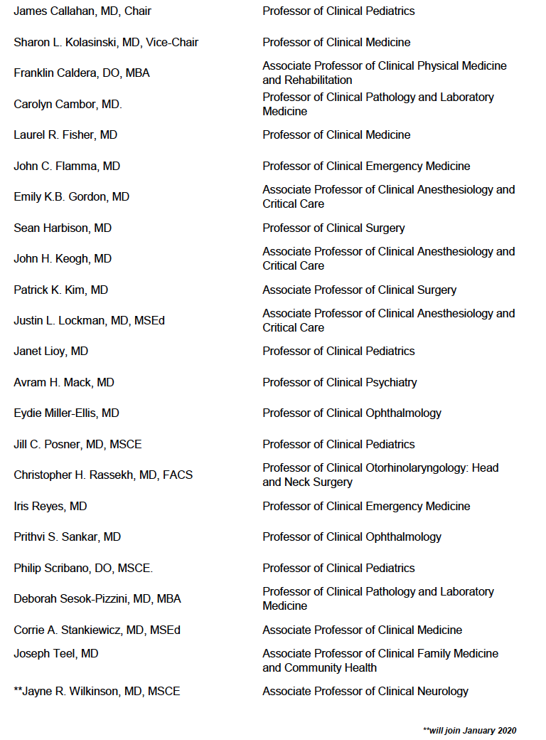
Academic Clinician Advisory Committee
2019 - 2020
Notes:
23 members currently

Slide 24

ADVANCE: PSOM FLPD Website
QUESTIONS DURING SESSION? staitano@upenn.edu

Slide 25
AC: Strengths of the Track
A home for gifted clinicians and teachers who make these domains the major focus of their careers
Allows recognition of the breadth of skills and variety of talents that exists at PSOM
Flexibility for career development over time
Lack of mandatory time limits for promotion
Allows an academically focused career for teachers and clinicians

Slide 26
Summary
Newest, fastest growing and largest faculty track
A track for committed clinicians and educators
AOC allows us to develop our interests, become experts and share that expertise; promotes us as leaders
AOC encourages divisional and departmental leadership to invest in our growth in these areas
Allows for recognition of a diverse and exceedingly talented group of faculty
QUESTIONS DURING SESSION? staitano@upenn.edu

Slide 27
Building your AOC
Questions?
QUESTIONS DURING SESSION? staitano@upenn.edu

